Slide 1
Module 3 : DEEP LEARNING
Introduction to Deep Learning :
  Introduction to Deep Neural Networks
  Introduction to Loss Functions and Optimization
  Regularization Methods
  Applications of Deep Learning.

Slide 2
  Introduction to Deep Neural Networks
Deep Learning is a subset of Artificial Intelligence (AI) that helps machines to learn from large datasets using multi-layered neural networks.
It automatically finds patterns and makes predictions and eliminates the need for manual feature extraction.

Slide 3
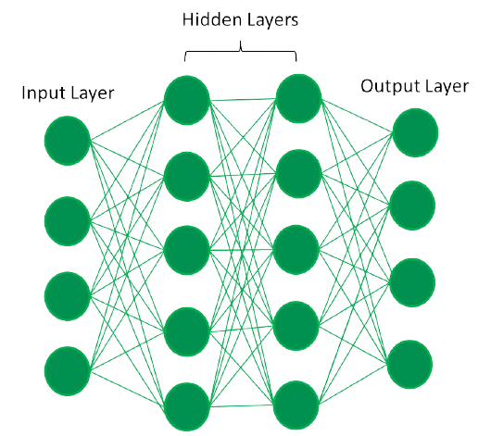
In a fully connected deep neural network data flows through multiple layers where each neuron performs nonlinear transformations, allowing the model to learn intricate representations of the data.
In a deep neural network the input layer receives data which passes through hidden layers that transform the data using nonlinear functions. The final output layer generates the model’s prediction.

Slide 4
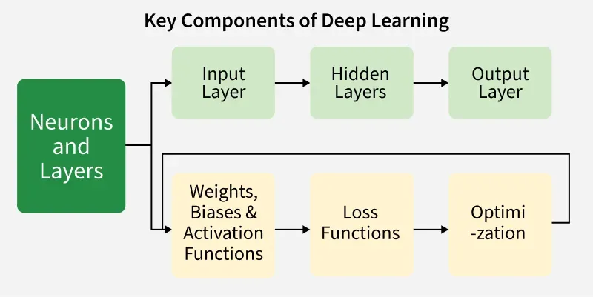
Neural Network
Neural Networks are fundamentals of deep learning inspired by human brain.
It consists of layers of interconnected nodes or "neurons" each designed to perform specific calculations.
These nodes receive input data, process it through various mathematical functions and pass the output to subsequent layers.

Slide 5
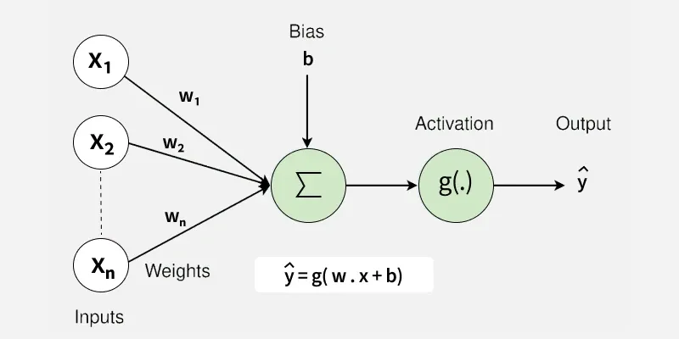
Neural Network Architecture

Slide 6
Neurons: The basic units that receive inputs, each neuron is governed by a threshold and an activation function.
Connections: Links between neurons that carry information, regulated by weights and biases.
Weights and Biases: These parameters determine the strength and influence of connections.
Propagation Functions: Mechanisms that help process and transfer data across layers of neurons.
Learning Rule: The method that adjusts weights and biases over time to improve accuracy.

Slide 7
Basic Components of Neural Networks
Weights and Biases : parameters in a NN that are adjusted during training to minimize the difference between predicted and actual outputs.
Forward Propagation
Activation Functions
Loss Functions
Back propagation
Learning Rate

Slide 8
Weights
Weights are numerical values assigned to the connections between neurons. They find how much influence each input has on the network’s final output.
Purpose: During forward propagation, inputs are multiplied by their respective weights before being passed through an activation function. This helps decide how strongly an input will affect the output.
Learning Mechanism: During training, weights are updated iteratively through optimization algorithms to minimize the difference between predicted and actual outcomes.
Example: In a neural network predicting house prices, the weight for the "size of the house" find how much the house size influences the price prediction. The larger the weight, the bigger the impact size will have on the final result.

Slide 9
Biases
Biases are additional parameters that adjust the output of a neuron. Unlike weights, they are not tied to any specific input but instead shift the activation function to better fit the data.
Biases are constants added to the weighted sum of inputs.
Purpose: Biases help neurons activate even when the weighted sum of inputs is not enough. This allows the network to recognize patterns that don't necessarily pass through the origin.
Functionality: Without biases, neurons would only activate when the input reaches a specific threshold. It makes the network more flexible by enabling activation across a wider range of conditions.
Example: In a house price prediction network, the bias might ensure that even for a house with a size of zero, the model predicts a non-zero price. This could reflect a fixed value such as land value or other baseline costs.

Slide 10
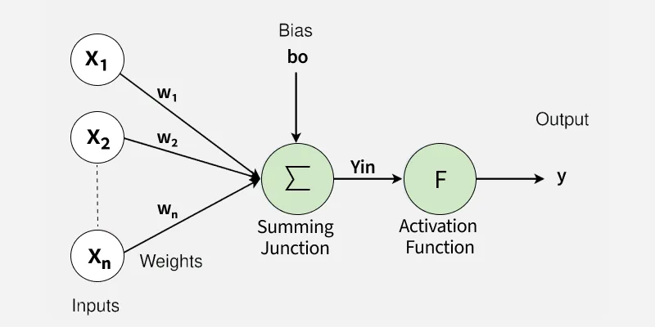
Forward Propagation
Forward propagation is the fundamental process in a neural network where input data passes through multiple layers to generate an output.
In Forward propagation input data moves through each layer of neural network where each neuron applies weighted sum, adds bias, passes the result through an activation function and making predictions.

Slide 11
Input Layer
  The input data is fed into the network through the input layer.
  Each feature in the input dataset represents a neuron in this layer.
  The input is usually normalized or standardized to improve model performance.
Hidden Layers
  The input moves through one or more hidden layers where transformations occur.
  Each neuron in hidden layer computes a weighted sum of inputs and applies activation function to introduce non-linearity.
  Each neuron receives inputs, computes: Z=WX+b , where:
    W is the weight matrix
    X is the input vector
    b is the bias term
  The activation function is applied.

Slide 12
3. Output Layer
  The last layer in the network generates the final prediction.
  The activation function of this layer depends on the type of problem:
    Softmax (for multi-class classification)
    Sigmoid (for binary classification)
    Linear (for regression tasks)
4. Prediction
  The network produces an output based on current weights and biases.
  The loss function evaluates the error by comparing predicted output with actual values.

Slide 13
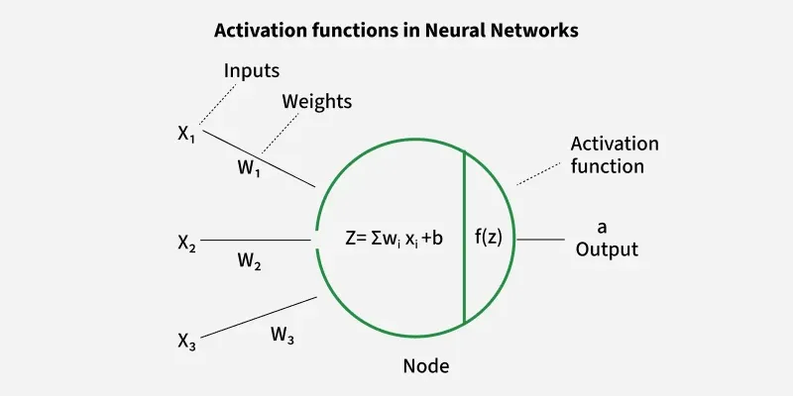
Activation Functions
An activation function in a neural network is a mathematical function applied to the output of a neuron.
It introduces non-linearity, enabling the model to learn and represent complex data patterns.
Without it, even a deep neural network would behave like a simple linear regression model.
Activation functions decide whether a neuron should be activated based on the weighted sum of inputs and a bias term.

Slide 14
Types of Activation Functions in Deep Learning
Linear Activation Function
Non-Linear Activation Functions
  Sigmoid Function
  Tanh Activation Function
  ReLU (Rectified Linear Unit) Function
Exponential Linear Units
  Softmax Function
  SoftPlus Function

Slide 15
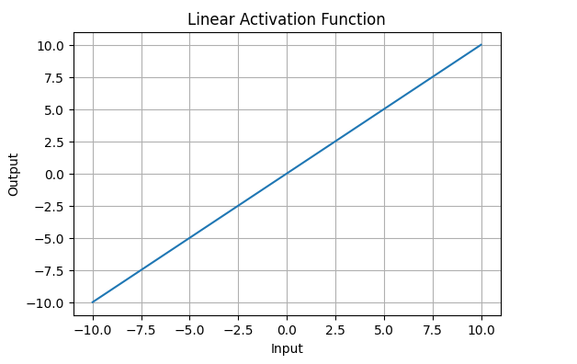
Linear Activation Function:
Linear Activation Function resembles straight line define by y=x.
The range of the output spans from (−∞ to +∞)(−∞ to +∞).
Linear activation function is used at just one place i.e. output layer.
Using linear activation across all layers makes the network's ability to learn complex patterns limited.

Slide 16
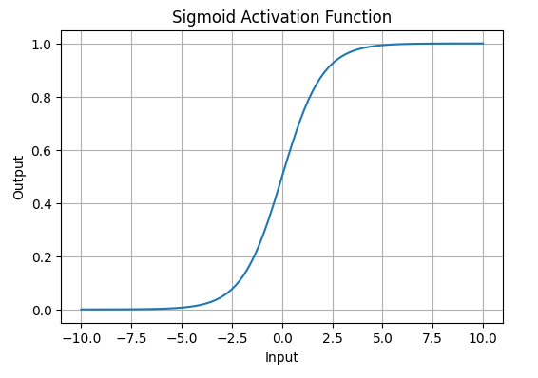

Sigmoid Function
Sigmoid Activation Function is characterized by 'S' shape. It is mathematically defined as
It allows neural networks to handle and model complex patterns that linear equations cannot.
The output ranges between 0 and 1, hence useful for binary classification.

Slide 17
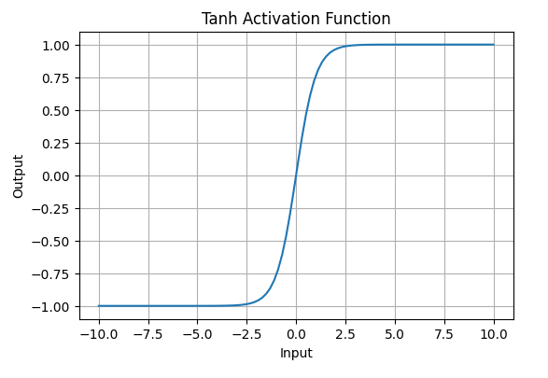

  Tanh Activation Function
Tanh function (hyperbolic tangent function) is a shifted version of the sigmoid, allowing it to stretch across the y-axis.
It is defined as:
Value Range: Outputs values from -1 to +1.
Non-linear: Enables modeling of complex data patterns
Commonly used in hidden layers due to its zero-centered output, facilitating easier learning for subsequent layers.

Slide 18
  ReLU (Rectified Linear Unit) Function
ReLU activation is defined by A(x)=max⁡(0,x) this means that if the input x is positive, ReLU returns x, if the input is negative, it returns 0.
Value Range: [0,∞), meaning the function only outputs non-negative values.
Nature: It is a non-linear activation function, allowing neural networks to learn complex patterns and making backpropagation more efficient.
Advantage over other Activation: ReLU is less computationally expensive than tanh and sigmoid because it involves simpler mathematical operations. At a time only a few neurons are activated making the network sparse making it efficient and easy for computation.

Slide 19
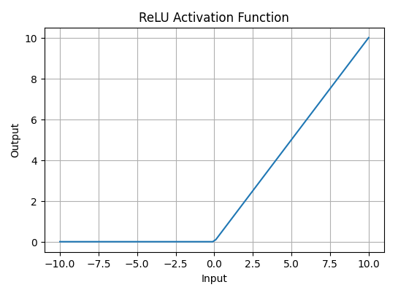

Slide 20
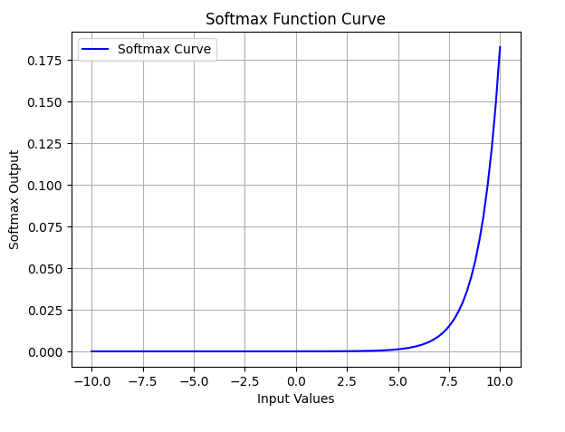
3. Exponential Linear Units
Softmax Function :
Softmax function is designed to handle multi-class classification problems.
It transforms raw output scores from a neural network into probabilities.
It works by squashing the output values of each class into the range of 0 to 1 while ensuring that the sum of all probabilities equals 1.
Softmax is a non-linear activation function.
The Softmax function ensures that each class is assigned a probability, helping to identify which class the input belongs to.

Slide 21
Activation | Range | Typical Use
Sigmoid | (0, 1) | Binary classification
Tanh | (-1, 1) | Hidden layers
ReLU | [0, ∞) | Deep hidden layers
Softmax | (0, 1), sum=1 | Multi-class output layer

Slide 22
Loss Functions in Deep Learning
A loss function is a mathematical way to measure how good or bad a model’s predictions are compared to the actual results.
Mean Squared Error (MSE) Loss
Mean Absolute Error (MAE) Loss
Binary Cross-Entropy Loss (Log Loss)

Slide 23
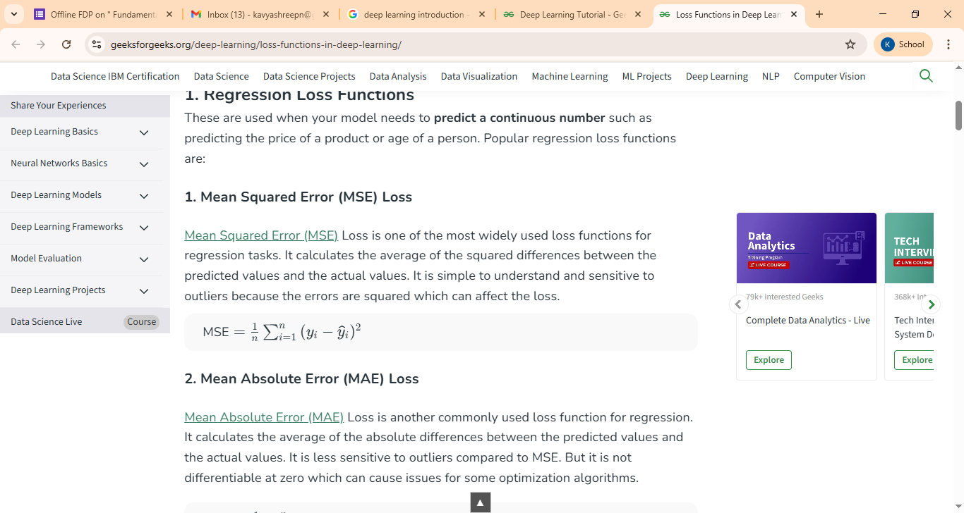
Mean Squared Error (MSE) Loss :
Loss is one of the most widely used loss functions for regression tasks. It calculates the average of the squared differences between the predicted values and the actual values. It is simple to understand and sensitive to outliers because the errors are squared which can affect the loss.
Yi- actual Output
Yi- Predicted Output
N- Total No of neurons

Slide 24

Mean Absolute Error (MAE) Loss : Loss is another commonly used loss function for regression.
It calculates the average of the absolute differences between the predicted values and the actual values.

Slide 25
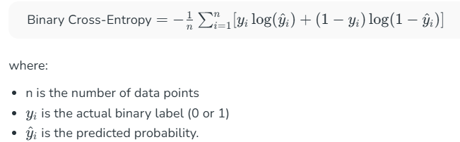
Binary Cross-Entropy Loss (Log Loss)
Loss is also known as Log Loss and is used for binary classification problems. It measures the performance of a classification model whose output is a probability value between 0 and 1

Slide 26
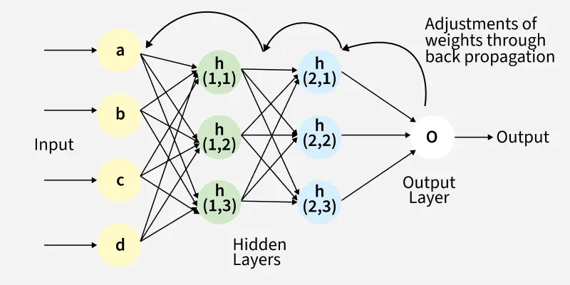
Backpropagation
It is a key algorithm used to train Deep neural networks by minimizing the difference between predicted and actual outputs.
Combined with optimization techniques like gradient descent, backpropagation enables the model to reduce loss across epochs and effectively learn complex patterns from data.

Slide 27
The Back Propagation algorithm involves two main steps: the Forward Pass and the Backward Pass.
Forward Propagation
  Inputs pass through the layers.
  Each neuron applies weights, bias, and activation function.
  Output is generated.
Backward Propagation
  The loss (error) between predicted and actual output is computed.
  Using calculus (chain rule), this error is propagated backward through the network.
  Gradients (partial derivatives) of the loss with respect to each weight are calculated.
  Weights are updated to minimize the loss.

Slide 28
Optimization Methods in DL
Optimization is the process of adjusting the model parameters (weights and biases) to minimize the error between predicted and actual outputs.
Gradient Descent
  Batch Gradient Descent
  Stochastic Gradient Descent (SGD)
  Mini-Batch Gradient Descent
Adagrad (Adaptive Gradient)
RMSprop (Root Mean Square Propagation)

Slide 29
Gradient Descent : GD is an optimization algorithm used to minimize the loss function by updating the model’s weights and biases.
Key Steps in Gradient Descent
  Initialize parameters: Randomly initialize the model parameters.
  Compute the gradient: Calculate the gradient (derivative) of the loss function with respect to the parameters.
  Update parameters: Adjust the parameters by moving in the opposite direction of the gradient, scaled by the learning rate.

Slide 30


Slide 31
Type | Description | Characteristics | Use Case
1. Batch Gradient Descent | Uses all training samples to compute the gradient before updating weights. | Stable and accurate updates. Requires entire dataset in memory. Computationally expensive for large data. | Suitable for small datasets and offline training.
2. Stochastic Gradient Descent (SGD) | Updates weights after each training example. | Very fast updates. Highly noisy gradient estimates. May oscillate around the minimum instead of converging smoothly. | Suitable for large datasets and online learning.
3. Mini-Batch Gradient Descent | Splits data into small batches (e.g., 32, 64, 128 samples) and updates weights after each batch. | Balances speed and stability.- Most commonly used in Deep Learning. Works well with GPU computation. | Ideal for deep learning models.

Slide 32
Adagrad (Adaptive Gradient) :
  Adapts the learning rate for each parameter based on the historical gradient information.
  The learning rate decreases over time, making AdaGrad effective for sparse features.
  Advantages: Adapts the learning rate, improving training efficiency.
  Disadvantages: Learning rate decays too quickly, causing slow convergence.
RMSprop (Root Mean Square Propagation)
  Improves upon AdaGrad by introducing a decay factor to prevent the learning rate from decreasing too rapidly.
  Advantages: Prevents excessive decay of learning rates.
  Disadvantages: Computationally expensive due to the additional parameter

Slide 33
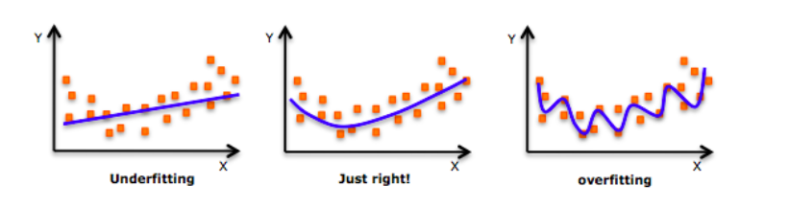
Regularization methods in DL
Regularization is a technique that prevents overfitting by constraining a model's complexity, making it perform better on new, unseen data.
It adds a penalty to the model's loss function to discourage it from learning noise and irrelevant patterns by shrinking the model's coefficients towards zero.

Slide 34
Prevents overfitting: Adds constraints to the model to reduce the risk of memorizing noise in the training data.
Improves generalization: Encourages simpler models that perform better on new, unseen data.
Types of Regularization
  L1 Regularization
  L2 Regularization
  Dropout
  Data Augmentation
  Early Stopping
  Noise Injection

Slide 35

L1 Regularization
the L1 Regularization technique is called LASSO (Least Absolute Shrinkage and Selection Operator) regression.
It adds the absolute value of magnitude of the coefficient as a penalty term to the loss function(L).
This penalty can shrink some coefficients to zero which helps in selecting only the important features and ignoring the less important ones.

Slide 36

L2 Regularization
L2 regularization technique is called Ridge regression .
It adds the squared magnitude of the coefficient as a penalty term to the loss function(L).
It handles multicollinearity by shrinking the coefficients of correlated features instead of eliminating them.

Slide 37
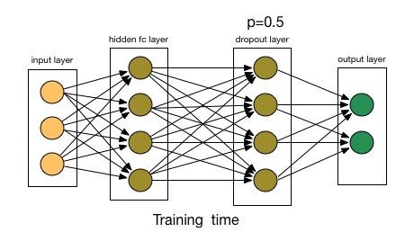
  Dropout
In Dropout, a random subset of neurons is temporarily excluded or “dropped out” during each iteration.
This helps prevent overfitting by promoting more robust learning and reducing the reliance on specific neurons.
Each iteration has a different set of nodes and this results in a different set of outputs.

Slide 38
Data Augmentation
  Expands the training dataset by applying transformations (rotation, flipping, cropping, etc.) to existing data.
  Purpose: Increases data diversity and reduces overfitting.
Early Stopping
  Monitors validation performance during training and stops when it stops improving.
  Purpose: Prevents overfitting by halting training before the model memorizes noise.
Noise Injection
  Adds noise to inputs, weights, or activations during training.
  Purpose: Improves robustness and prevents the model from becoming too sensitive to training data

